Slide 1

WEBINAR:
Selenium Page Object vs
Object Repository
July 19th, 2018 – Alexey Grinevich

Slide 2
WEBINAR:
Page Object vs Object Repository
We will be starting the webinar shortly, please stand by…
All phones will be automatically on mute until the Q&A.
July 19th, 2018 – Alexey Grinevich

Slide 3
Agenda
Page Object Example
How to Combine Page Object with an Object Repository
How to Choose Language and Environment of a Test Framework
How Page Object pattern is done in Rapise
Conclusions
Q & A

Slide 4
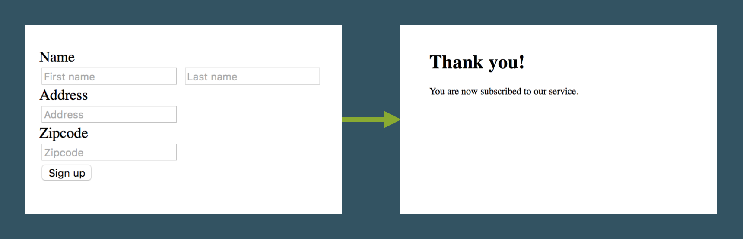
Let’s Look at Page Object
Based on: https://www.pluralsight.com/guides/getting-started-with-page-object-pattern-for-your-selenium-tests
Here is the Demo App

Slide 5
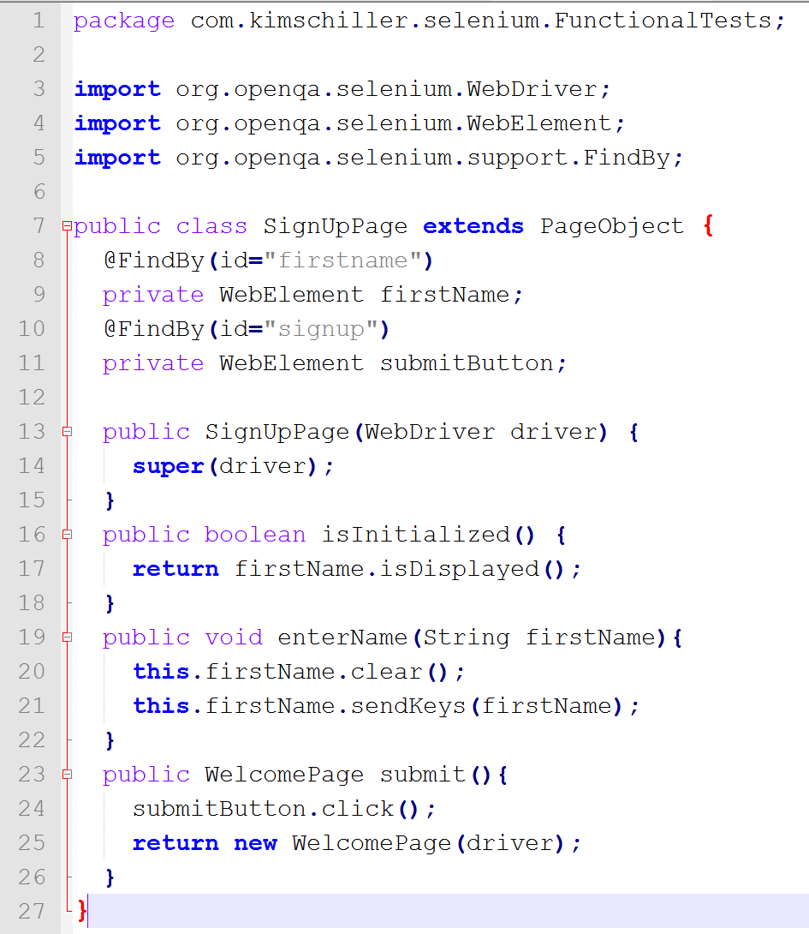
Page Object

Slide 6
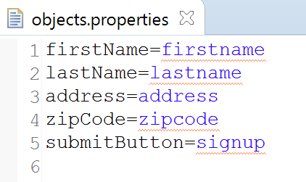
Object Repository: Basics
Basic version

Slide 7
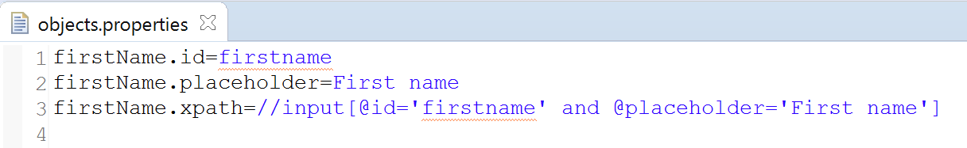
Object Repository: Resilience
More options
Resilience – more stable recognition
Automatic recovery
Record, update, re-use

Slide 8
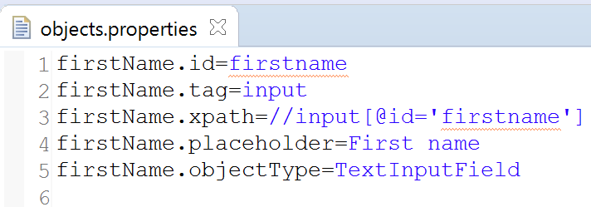
Object Repository
Widget type
Adds known object operations properties (known objects library)

Slide 9
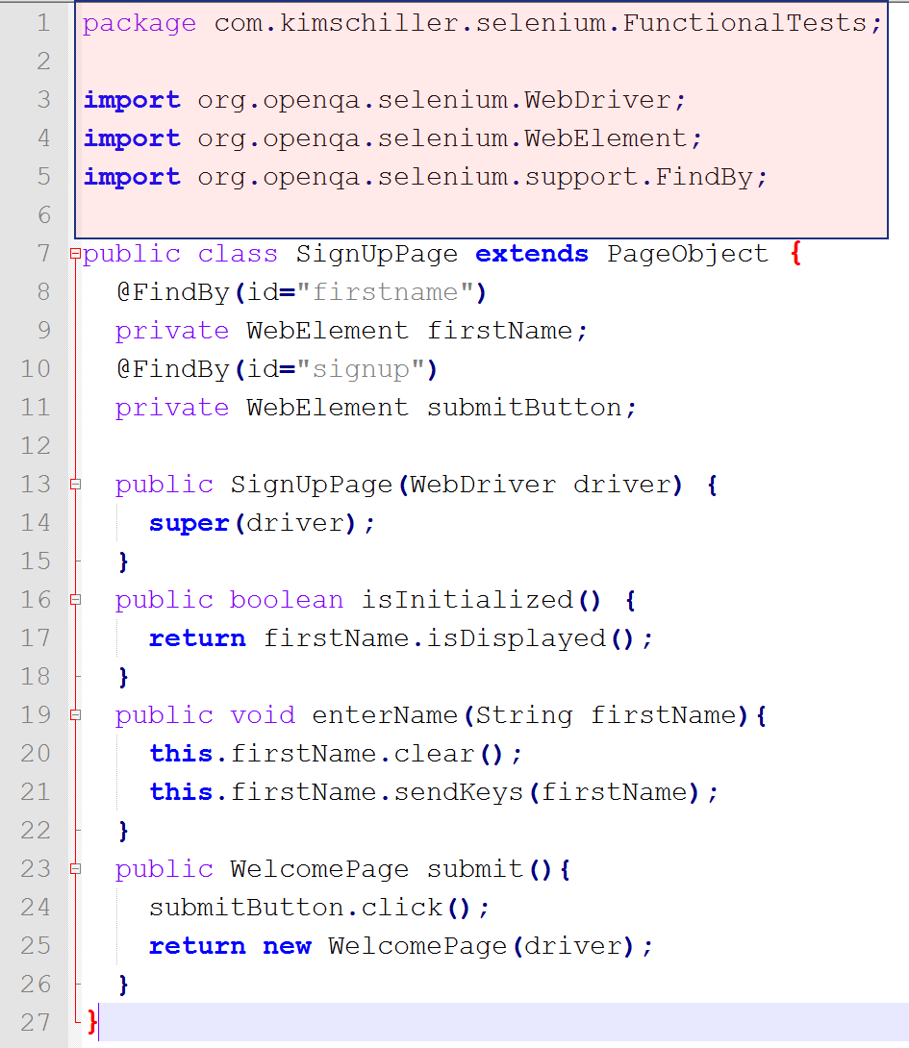
Page Object
With Java Formalities

Slide 10
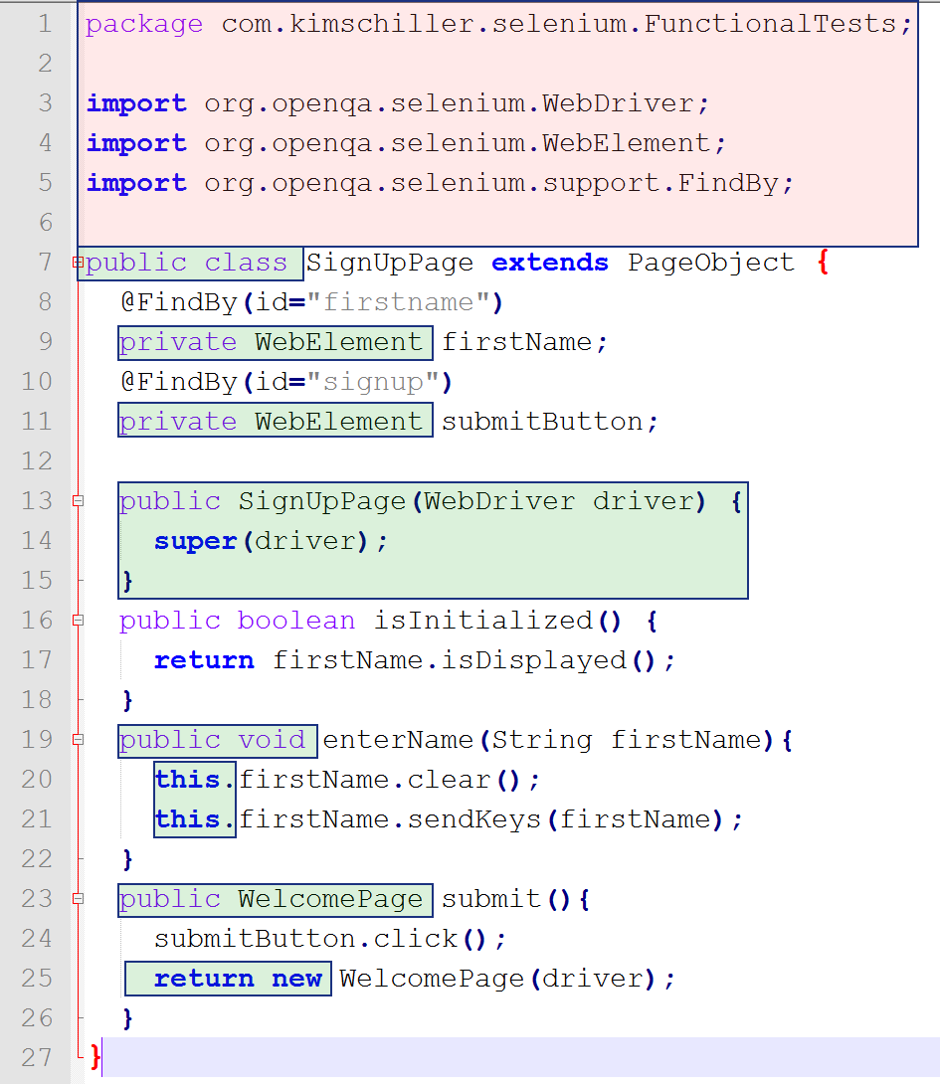
Page Object
With Java Formalities
With OOP Formalities

Slide 11
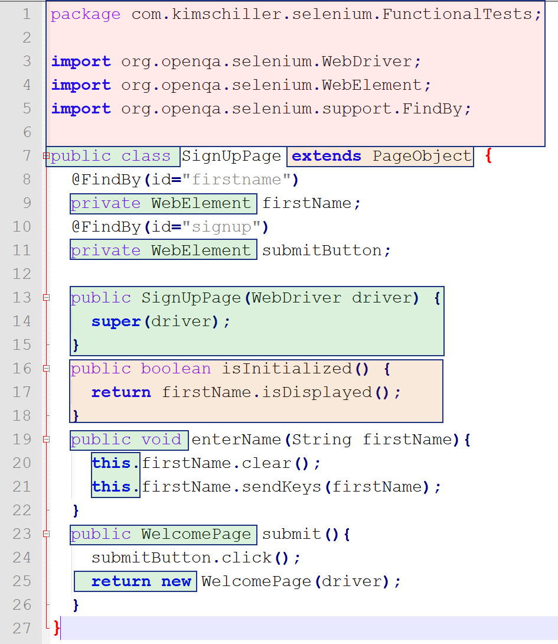
Page Object
With Java Formalities
With OOP Formalities
With Page Object Formalities

Slide 12
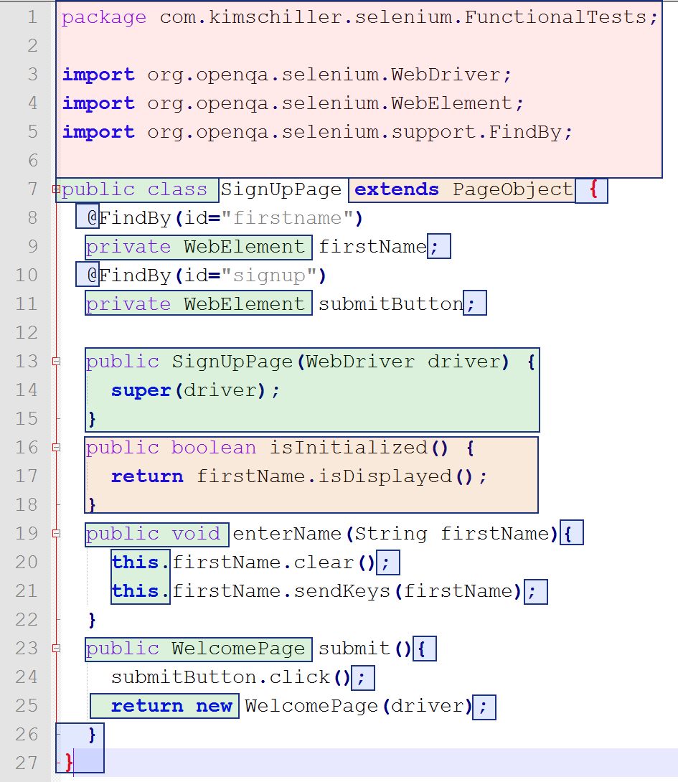
Page Object
With Java Formalities
With OOP Formalities
With Page Object Formalities
With Syntactic Sugar
Notes:
So we can see that most test file is devoted to fitting actual test logic into the requirements caused by OOP/Language/IDE.

Slide 13
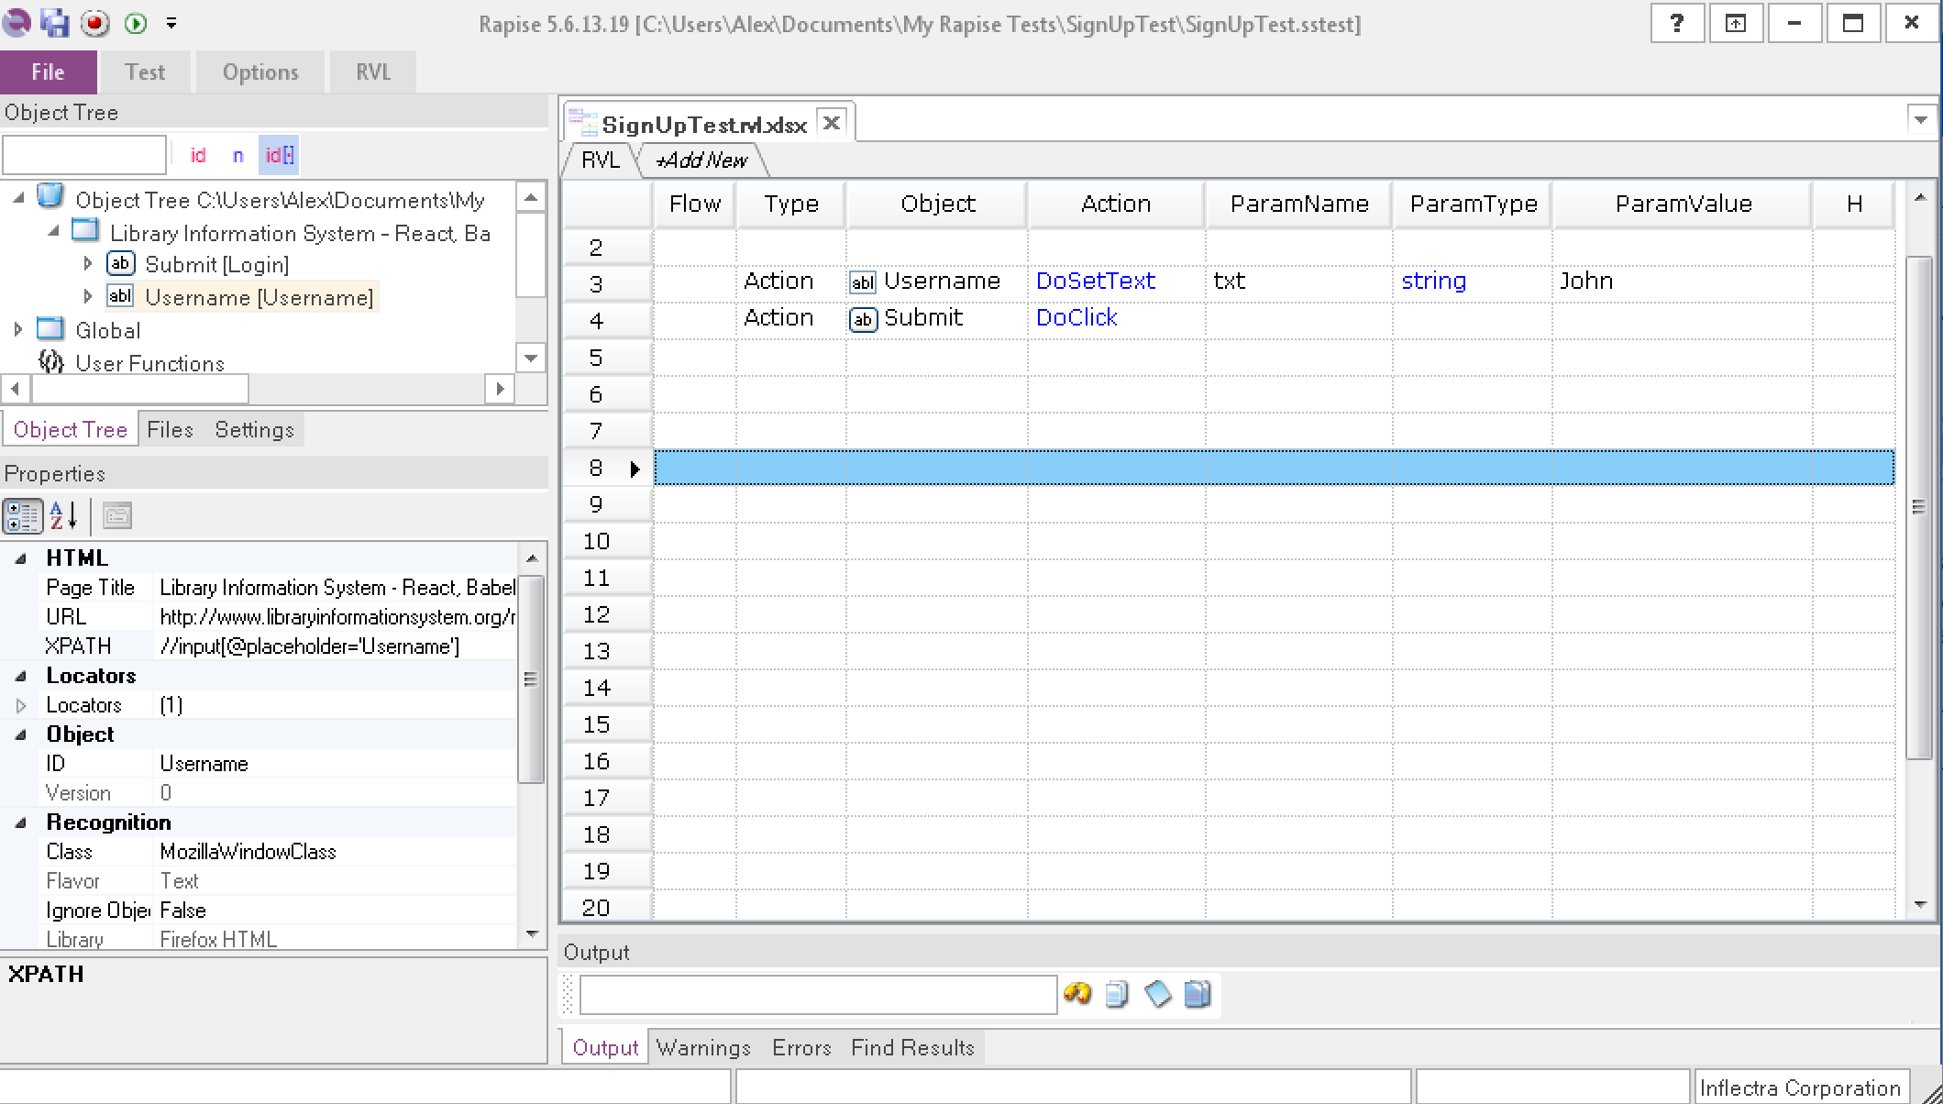
Object Repository

Slide 14
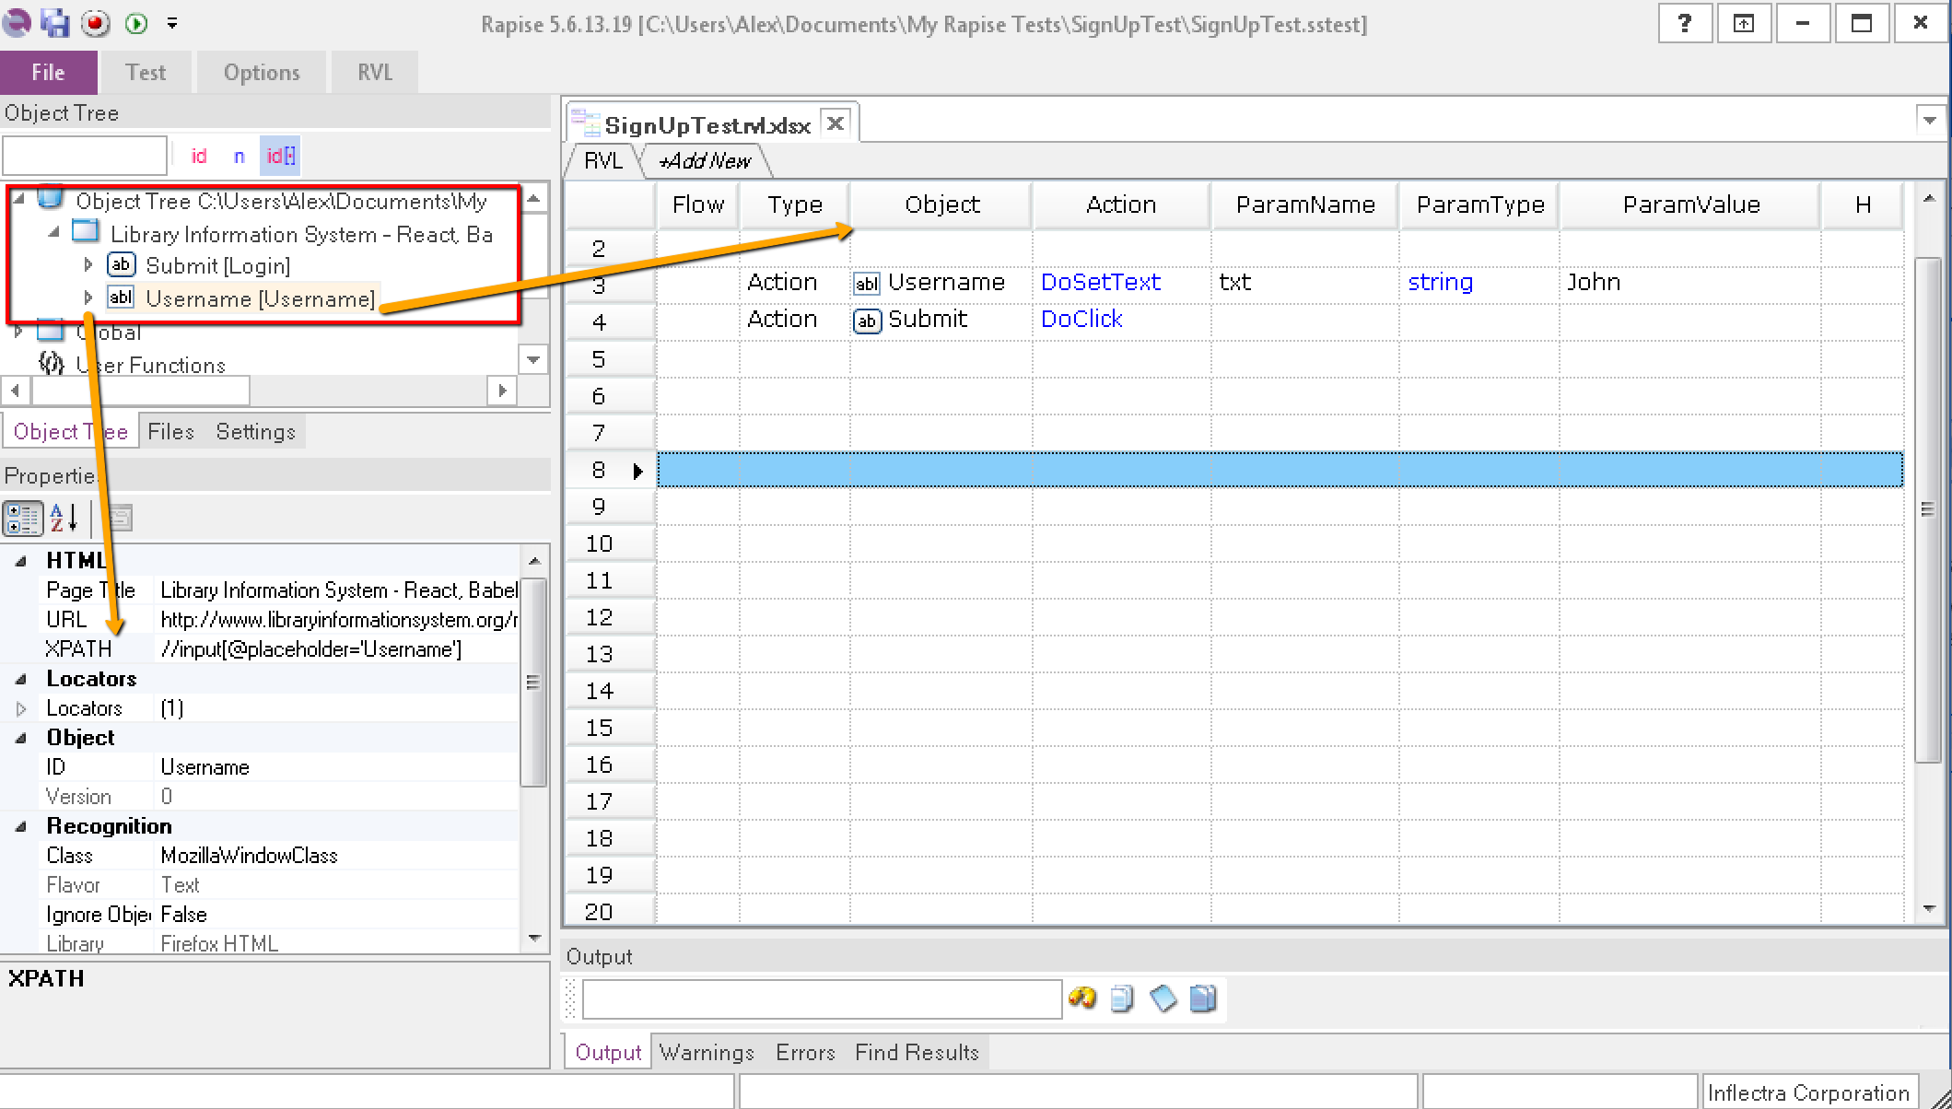
Test Structure
Notes:
See Objects, Locator information (==@FindBy) and Steps

Slide 15
So How to Implement Page Object in Rapise?
The “trade offs”:
  Rapise IDE instead of other IDE
  RVL instead of <some language>
  No OOP Formalities
  No Language Formalities
  No Syntax Formalities
You already have it

Slide 16
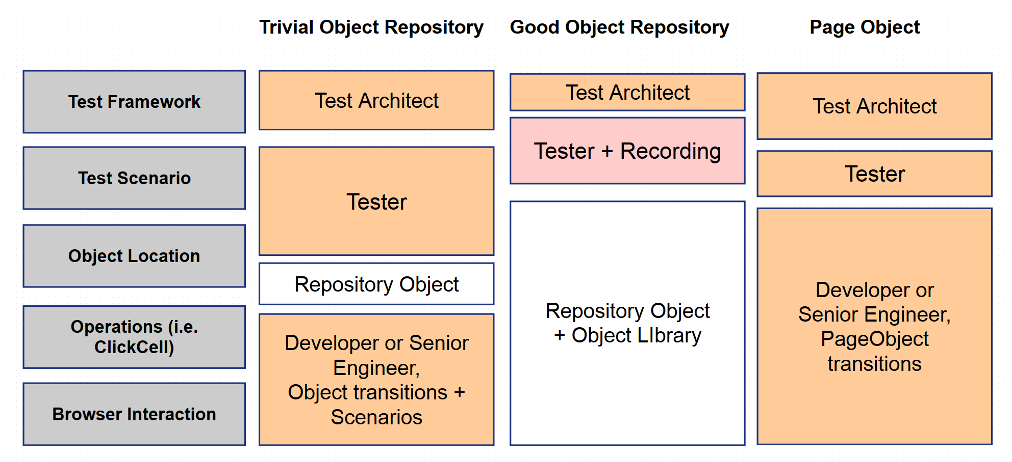
Summary

Slide 17
Q&A
Thanks for Watching
Subscribe to Inflectra’s Youtube Channel for More Videos on Software Testing

